Slide 1
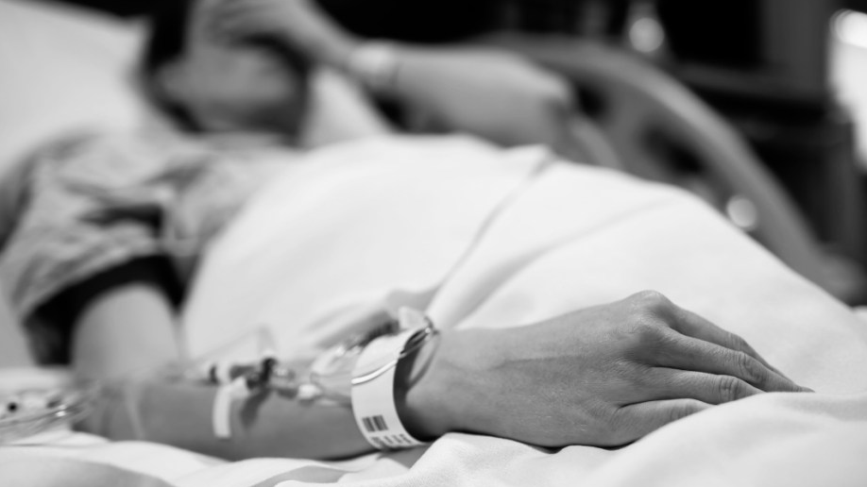

Health Informatics LINFO2381
Project Beyond Wishes
The app to store and pass on final wishes for terminally ill patients

Slide 2
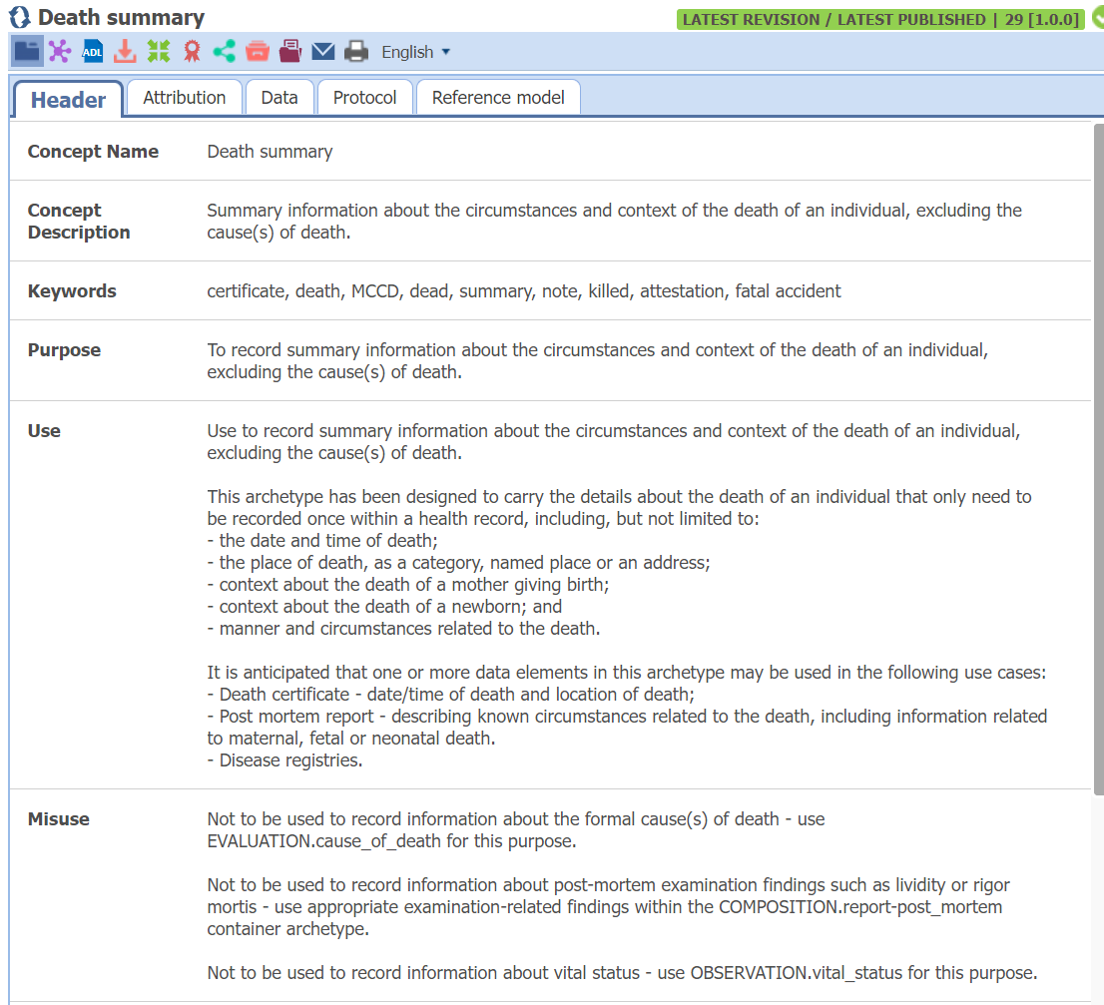
Motivations for the application
Doctors cannot share information about patients (GDPR)
Notes are easily lost between patients
Hard to share the death wishes
Informal way to share testimonies with trusted general practitioner
EHR archetype only for death summary not for death wishes

Slide 3
Requirements for app
1. User Interface (UI) and User Experience (UX):
1.1 Design an intuitive and user-friendly interface accessible to general practitioners (GPs) who may not be tech-savvy.
1.2 Keep the design simple with good labels and buttons that are non-ambiguous!
1.3 Show specific patient information on every screen to be able to distinguish between patient if multiple tabs are open.
2. Patient Authentication:
2.1 Develop a secure authentication system to verify the identity of the patient and ensure that only authorized individuals can access and modify their final wishes.
2.2 Patient Unique identifier is key!
3. Document Management:
3.1 Allow GPs to create, update, and store their final wishes electronically within the app.
3.2 Enable GPs and other healthcare professionals to easily access and pass on documents to other departments.
4. Integration with Hospital Systems:
4.1 Integration within existing hospital systems to facilitate the transfer of patient information and final wishes across different healthcare settings.
4.2 Establish compatibility with electronic health record (EHR) systems to streamline the documentation process.
5. Notification and Alert System:
5.1 Implement a notification system to alert healthcare providers when a patient's final wishes have been updated or when specific instructions need to be followed.
5.2 Ensure timely communication to avoid any misunderstandings or delays in fulfilling the patient's wishes.
5.3 When patient dies an alert must be sent out to health care professionals and family.

Slide 4
Requirements from LINFO
Narrow project down to have only a proof of concept
Create a standalone interface that can be showcased
No HL7 integration or real EHR integration. Only requirement really is the rest api
Implementations needed for project to pass:
RestAPI
CouchDB
Web interface in html + JavaScript or a GUI.

Slide 5











Beyond Wishes Rich picture diagram
Family and relatives
Inform
EHR
Response
JSON
Read and act
Monitor and treat
RestfulAPI
Request
patient ID
Get/Post/Put
Create, update, check
Final wishes
Beyond Wishes Client
Terminal patient
General Practitioner
Integration not considered
Request
patient ID
Dies
Response
Response
Inform
Request
patient ID
CouchDB
Local Server
Death
Other departments
Multi-instance not implemented

Slide 6





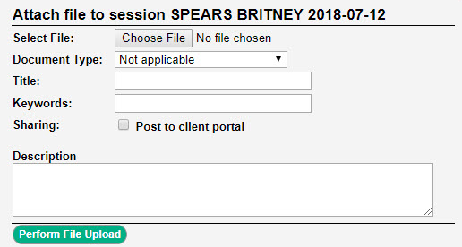

Graphical user interface mockup
Back to search
Alert family
Patient information
Patient Name: Spears Britney
Patient ID: 2020204040DE
Diagnosis: Brain tumor
Prognosis (days to live): 3 months
Birthdate: 20 April 1974
Age: 54
Sex: Female
Weight: 60kg
Final wishes
Eat boulettes de agneau
Go paragliding
Attach document to final wishes
Uploaded documents:

Slide 7
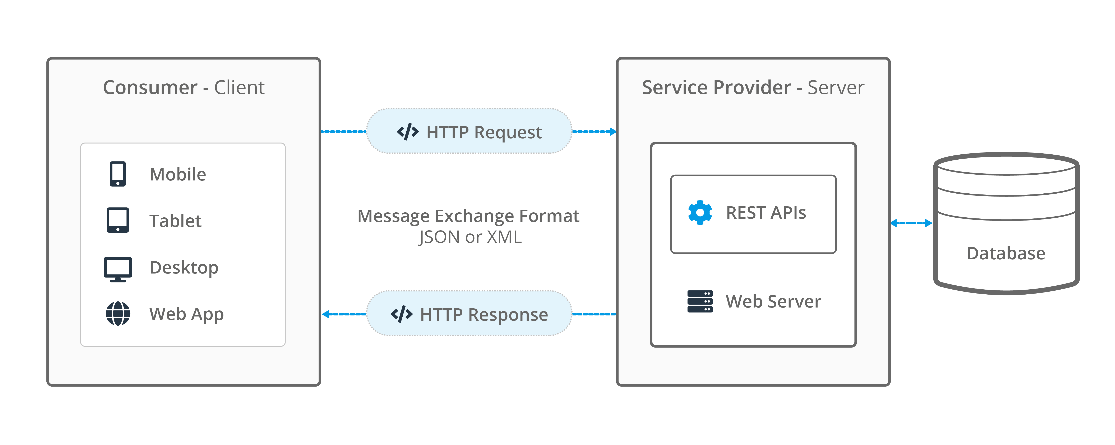

Slide 8

Beyond Wishes Deployment
2
3
Client
Front-End
CSS, HTML
FastAPI
Python
CouchDB
Python
HTTP Fetch
HTTP ”CRUD”
Return JSON
HTTP Response
4
1
Client logic
JavaScript

